Slide 1
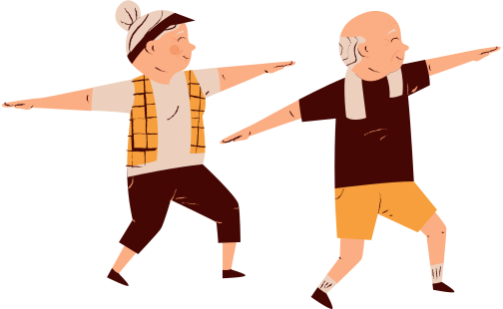
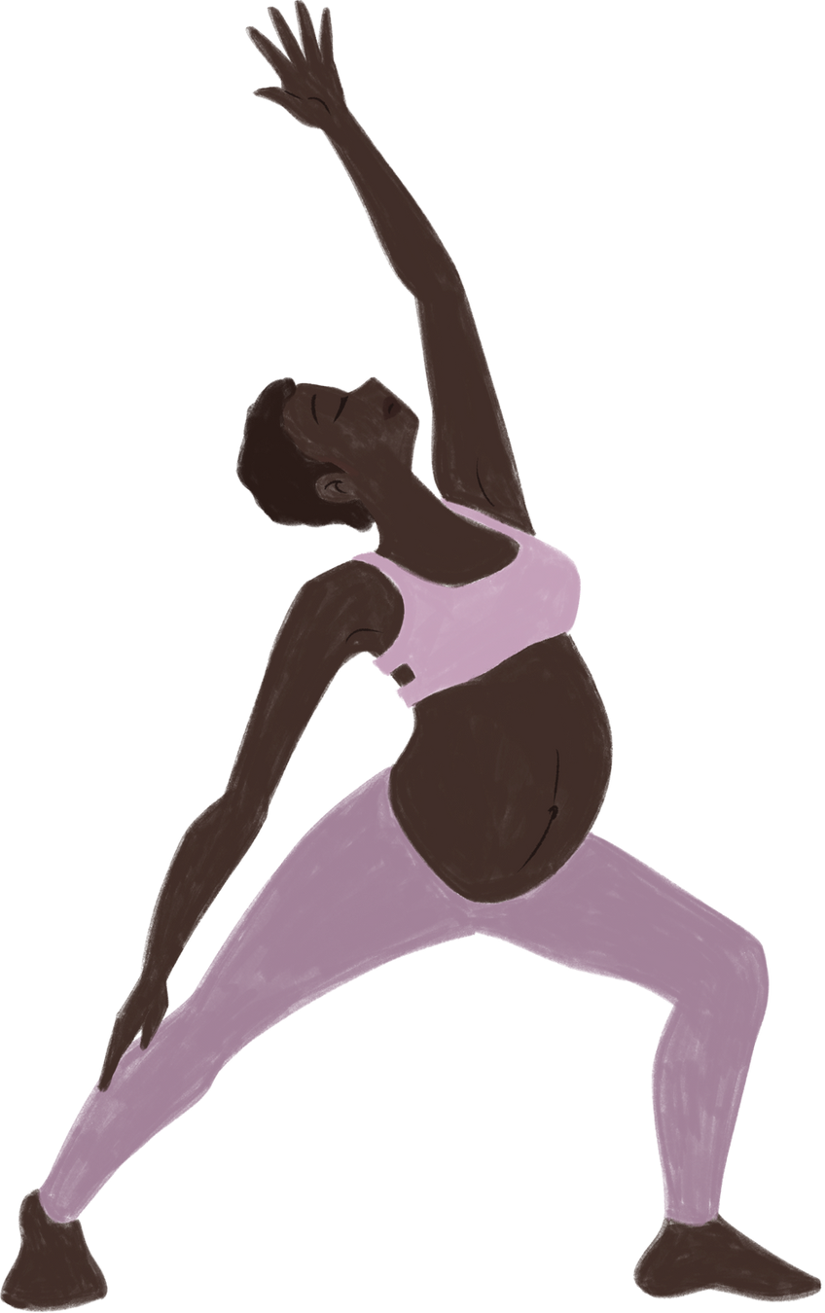

Foundations of Women’s Health Physiotherapy
London Metropolitan University
Presented By :
Imogen Palllister
B8a Pelvic Health Physiotherapist

Slide 2
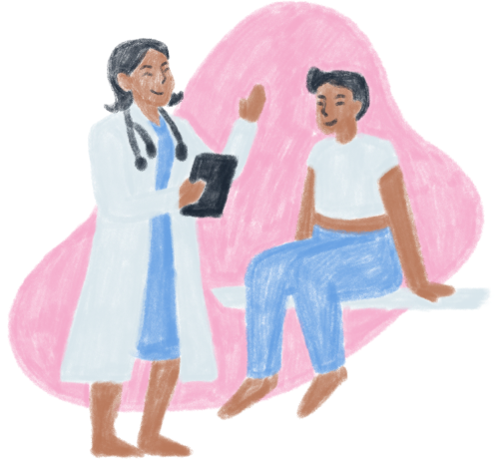
Learning Outcomes
Key take home messages
01
Scope of Women’s Health Physiotherapy
Anatomy and Physiology
Red Flags and urgent referral
04
02
Biopsychosocial impact
05
03
Common Women’s Health Conditions
Notes:
- please get as involved as possible, participation is key,
- all for your learning
- relevant in every aspect of physiotherapy be it wards/outpatients etc
- hope to stick with you to take on into the future
- inspire some of you to be women's health physios!

Slide 3



More than just the pelvic floor
Definition
“Pelvic health physiotherapy is a first-line, evidence-based treatment for pelvic floor dysfunction, including urinary incontinence, pelvic organ prolapse, and pelvic pain.”
  NICE NG123
“Pelvic health physiotherapists assess and treat a wide range of conditions related to the pelvis and pelvic floor, including bladder, bowel and sexual dysfunction, as well as antenatal and postnatal musculoskeletal issues.”
  POGP
Core Scope
Women’s Health Physiotherapy
Musculoskeletal Care
Obstetric Care
Gynaecological Care
Shared Case Practices
  Pregnancy related back/pelvic pain
  Labour prep
  Postnatal Rehab
  Perineal Trauma prevention and recovery
  Antenatal/Postnatal Exercise
  Urinary/bowel Incontinence
  Pelvic Organ Prolapse
  Sexual Dysfunction
  Menopause
  Endometriosis
  Constipation
  Pelvic Floor Muscle training
  Bladder and bowel health education
  Lifestyle advise
  Psychological Support
  MDT collaboration
  Low Back Pain
  Pelvic Girdle Pain
  Diastasis Recti
  Coccydynia
  Chronic Pelvic Pain
Notes:
✅ NICE highlights pelvic health physio as:
A first-line intervention, especially before surgical options.
Safe, cost-effective, and improves quality of life.
A recommended pathway in both NHS and private healthcare settings.
✅ The POGP emphasises that physios:
Treat people of all genders and ages.
Work across MSK, obstetrics, gynaecology, urology, and colorectal specialties.
Provide conservative management and education for:
Pelvic floor dysfunction
Pregnancy-related MSK pain
Prolapse and continence issues
Post-surgical recovery
Menopause-related dysfunction
Sexual health concerns
🧑‍⚕️ Role of the Pelvic Health Physiotherapist
Holistic assessment (history, internal/external exam, functional movement)
Patient education and empowerment
Development of individualised rehab plans
Use of biofeedback, manual therapy, exercise prescription
Signposting or referring for red flags or surgical/medical care
Participation in MDT (Multidisciplinary Teams)
Did You Know?
Up to 1 in 3 women experience pelvic floor dysfunction in their lifetime (NICE NG123).
Pelvic health issues can occur at any age, not just during or after childbirth.
Evidence supports physiotherapy as the most effective non-surgical management option for pelvic floor dysfunction.
✅ Take-Home Messages:
Women’s health physio is not just postnatal care—it spans the lifespan.
It addresses intimate, sensitive conditions with clinical and empathetic care.
Recognised by NICE and professional bodies as first-line, essential treatment.

Slide 4
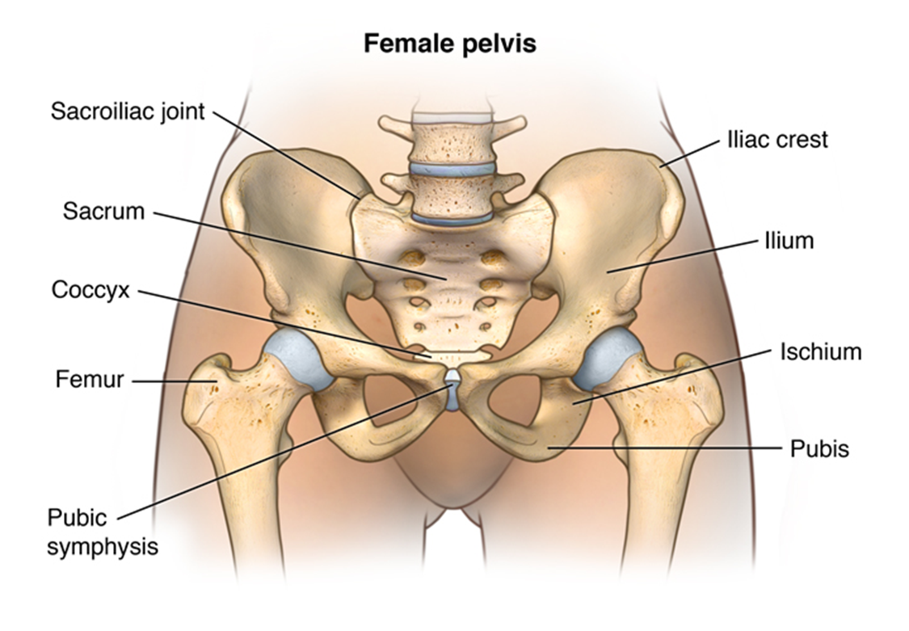

Anatomy and Physiology - Pelvis
1
6
2
7
3
8
4
9
5
Notes:
1 SIJ
2 SACRUM
3 COCCYX
4 FEMUR/Greater trochanter
5 pubic symphysis
6 Iliac crest /ASIS
7 Ilium
8 ischium
9 ischial tuberosity

Slide 5
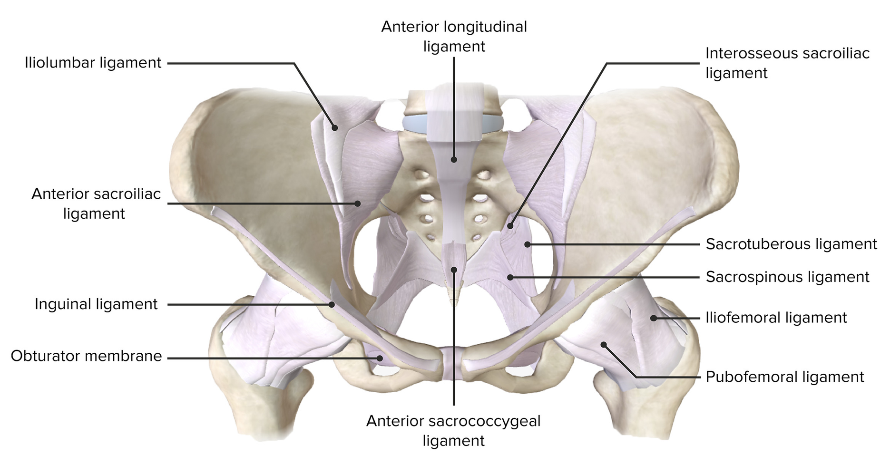
Pelvic Anatomy: Ligaments
Notes:
Slide 5: Anatomy & Physiology – Abdominal Wall & Reproductive System
Layers of the abdominal wall
Changes during pregnancy & postpartum
Overview of reproductive organs relevant to physio care
Visual: Cross-sectional anatomy illustration

Slide 6
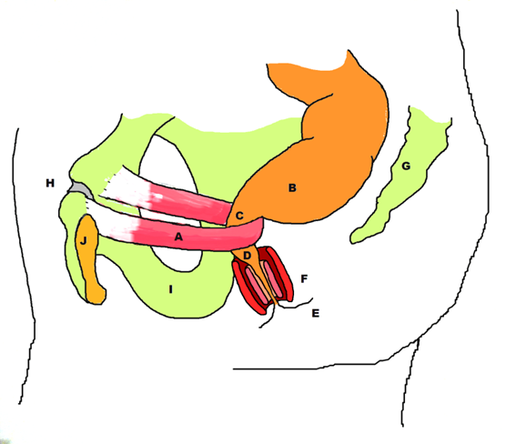
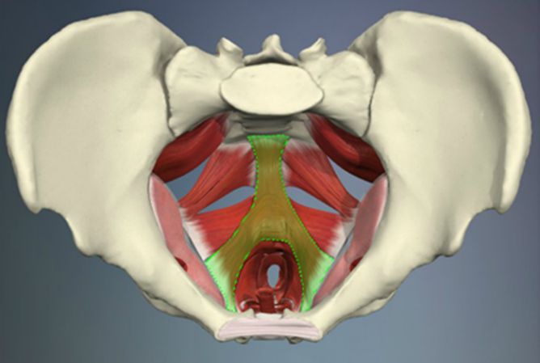
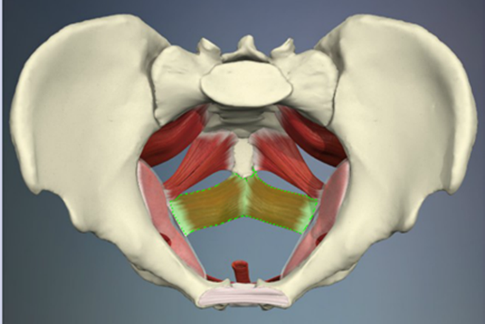
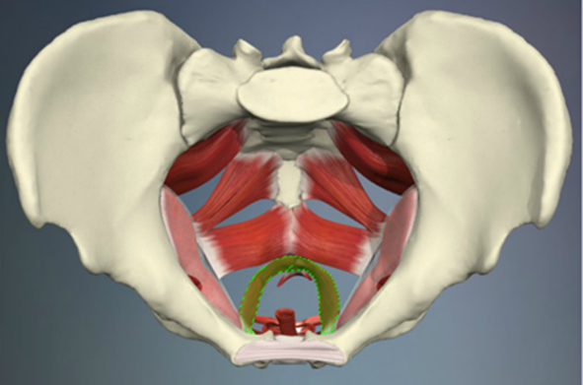
Anatomy and Physiology - Pelvic floor
The pelvic floor complex
deep
Endopelvic fascia
pelvic diaphragm ( levator ani and coccygeus)
Superficial pelvic floor (perineal memberane)
superficial
Iliococcygeus
Puborectalis
Pubococcygeus
Notes:
Slide 4: Anatomy & Physiology – Pelvic Floor
Structure and function of pelvic floor muscles
The pelvic floor has superficial, middle, and deep layers.
Deep:
Fibromuscular tissue composed of collagen, elastin and smooth muscle fibres
Connects the pelvic organs to the pelvic side-walls
middle:
Pubococcygeus (medial, bulky):
Origin: Posterior surface of the pubic bone & fascia of the obturator
Attachment: Anterior surface of the coccyx
Various subdivisions have been described:
Pubourethralis
Pubovaginalis
Puboanalis
Puborectalis
Iliococcygeus (lateral, thin):
Origin: Posterior surface of the pubic bone & surface of the ilium
Attachment: Lateral margins of the coccyx
Coccygeus and levator ani (puborectalis, pubococcygeus, iliococcygeus) form the deepest layer, with coccygeus being most posterior.
Role in continence, support, sexual function
Research reference: Bø K. (2004) — Pelvic floor muscle training
Visual: Diagram of pelvic floor muscles

Slide 7
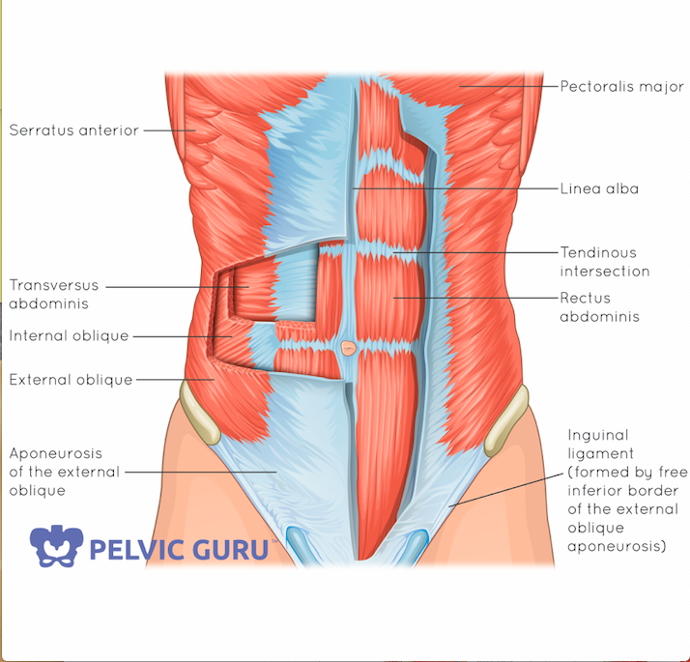
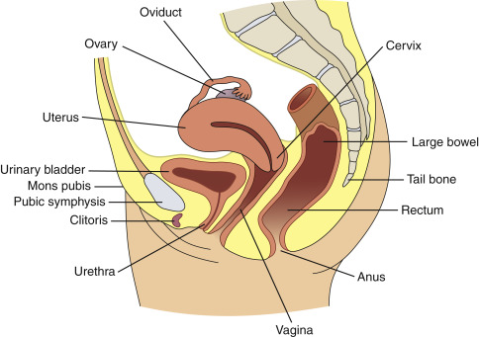
Anatomy and Physiology - Abdominal wall and reproductive system
Notes:
Slide 5: Anatomy & Physiology – Abdominal Wall & Reproductive System
1. Layers of the Abdominal Wall
“When we talk about the abdominal wall, we’re really looking at several layers that work together for support, stability, and pressure regulation.
On the outside we’ve got skin and subcutaneous fat.
Then the muscle layers: the external oblique on the outside, the internal oblique just beneath it, and the transversus abdominis — the deepest, horizontal muscle that’s really important for core stability and managing intra-abdominal pressure.
We also have the rectus abdominis running vertically at the front, enclosed in its sheath, with the linea alba down the middle. This linea alba is the structure that stretches and can separate during pregnancy, causing diastasis recti.
Beneath the muscles, there’s the fascia layers and then the peritoneum lining the abdominal cavity.
For physiotherapists, the key point is that the abdominal wall works in close coordination with the pelvic floor and the diaphragm. Together they act like a pressure system — essential for continence, stability, and efficient movement.”
2. Changes During Pregnancy & Postpartum
“Pregnancy brings both hormonal and mechanical changes that affect the abdominal wall.
Hormones like relaxin and progesterone soften connective tissue and increase ligament laxity. This is necessary for childbirth, but it also means greater risk of instability and pain, particularly around the pelvis and lower back.
Mechanically, the growing uterus stretches the abdominal wall. The linea alba widens and thins, which can lead to diastasis recti. As the abdominal wall stretches, it becomes less effective at stabilising the trunk.
Posturally, women often develop an increased lumbar lordosis due to the forward weight shift, and the ribs flare outward, which changes breathing patterns.
Postpartum, the abdominal wall and linea alba don’t immediately return to their pre-pregnancy state. Collagen remodeling can take up to 12–18 months. Early postpartum rehab often focuses on restoring deep core and pelvic floor activation, not just surface strength.”
3. Reproductive Organs Relevant to Physio Care
“The reproductive system also undergoes huge changes that matter to us as physios.
The uterus grows massively in both size and weight, which compresses nearby organs — the bladder, intestines, and stomach — leading to urinary frequency, constipation, and reflux during pregnancy.
The ovaries continue their hormonal role, producing estrogen and progesterone, which affect circulation, tissue elasticity, and overall pelvic stability.
The vagina is a distensible muscular canal that supports the pelvic organs and stretches during childbirth. Trauma to this tissue or scarring from stitches can impact pelvic floor function and sexual health postpartum.
The pelvic floor muscles themselves are critical — particularly the levator ani group (puborectalis, pubococcygeus, iliococcygeus). They provide continence, organ support, sexual function, and pressure regulation. These are directly affected during pregnancy and birth, especially with vaginal delivery.
Supporting structures include the pelvic ligaments — broad, round, and uterosacral — which hold the uterus in place but become more lax with hormones, increasing strain on both pelvic floor and abdominal wall.
Finally, the bladder and rectum sit in very close relationship to the pelvic floor. That’s why pelvic floor dysfunction can lead to both urinary and bowel symptoms, which are central concerns in women’s health physiotherapy.”
✨ Summary point for delivery:
“As physios, understanding these anatomical layers and the physiological changes in pregnancy and postpartum gives us the foundation for assessing and treating issues like diastasis recti, incontinence, prolapse, and pelvic pain. The abdominal wall and reproductive system don’t function in isolation — they’re part of a dynamic pressure and support system that we can retrain through targeted rehab.”

Slide 8

Anatomy and Physiology - The bladder, and how we wee!
Notes:
The bladder acts as a storage facility.
Urine filters from kidneys to bladder via ureters.
Bladder is in relaxed state in order to receive urine, that is
Detrusor is relaxed
Pelvic floor and sphincter close off urethra
When the bladder is full and it is an appropriate time to empty the bladder
Detrusor contracts
Pelvic floor and sphincter relax
You Urinate!!!

Slide 9
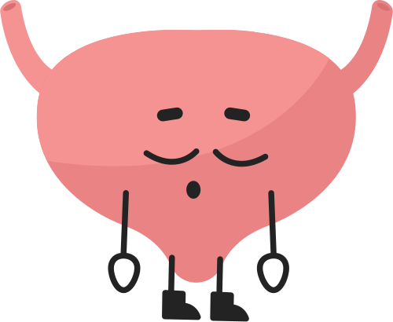
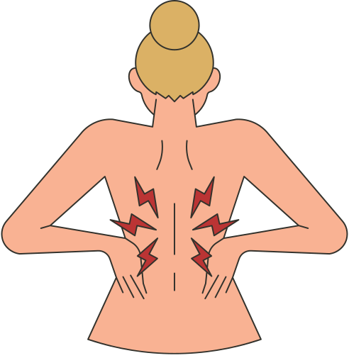
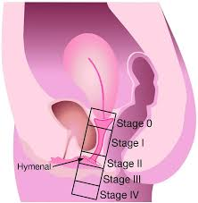
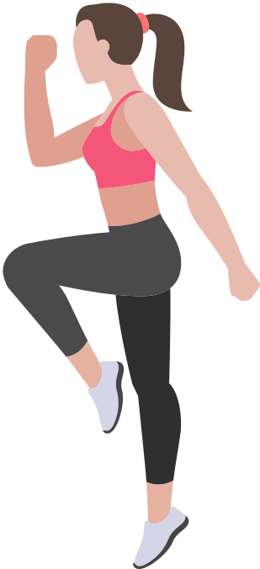
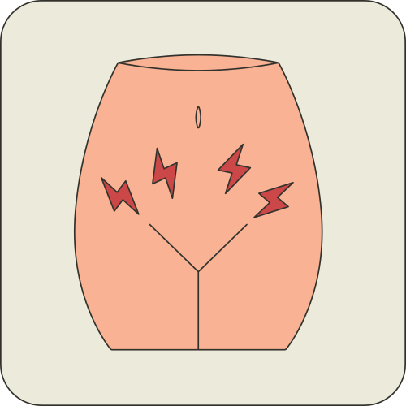
Common Women’s Health Conditions
Urinary Incontinence
  Stress
  Urge
  Overflow
  Mixed
  retraining/PMFT/NMES/Biofeedback
Pregnancy Related MSK Issues
  LBP
  PGP
  Tx pain
  Hip pain
  exercise/pilates/activity modification
Pelvic Organ Prolapse
  Heaviness
  Bulge
  Exercise/hypopressives/education/pessary
Postnatal Dysfunction
  Diastasis Recti (DRAm)
  Pelvic Floor Dysfunction
  Perineal Pain/OASI trauma
  Post c-section pain
  return to function
Pelvic Pain
  Dyspareunia
  Vulvodynia,
  Endometriosis
  Manual therapy, relaxation, dilators
Notes:
Slide 6: Common Women’s Health Conditions Managed by Physiotherapists
Urinary Incontinence
Most common condition seen in women’s health physio.
Stress incontinence: leakage with exertion (cough, sneeze, exercise). due to an increase in intra-abdominal pressure, overwhelms the PF
Urge incontinence: sudden, strong urge with little warning.
Mixed: both stress and urge.
Management: pelvic floor muscle training (PFMT), bladder training, lifestyle advice.
Pelvic Organ Prolapse (POP)
Descent of bladder, uterus, or rectum into vaginal space.
Symptoms: heaviness, bulge, dragging sensation, incomplete emptying.
Prevalence: up to 50% of parous women on examination, though not all are symptomatic.
Physio role: PFMT, education on load management, exercise modification; referral for pessaries/surgical consult if needed.
Pelvic Pain Syndromes
Includes dyspareunia (pain with sex), vulvodynia, chronic pelvic pain, and pain linked to endometriosis.
Complex biopsychosocial presentation — influenced by muscle tension, central sensitisation, trauma, hormonal changes.
Physio management: pelvic floor down-training, relaxation, manual therapy, desensitisation, pain education, pacing strategies.
Pregnancy-Related Musculoskeletal (MSK) Issues
Low back pain and pelvic girdle pain affect 45–70% of women during pregnancy.
Caused by hormonal laxity + increased load + altered posture.
Can limit mobility, sleep, work capacity.
Physio role: exercise prescription, belts/supports, manual therapy, activity modification.
Postnatal Dysfunction
Diastasis recti abdominis (DRA): widening of linea alba, impaired abdominal wall tension → affects trunk stability and load transfer.
Pelvic floor weakness: contributes to urinary leakage, prolapse, reduced sexual function.
Management: graded core and PFMT, functional rehab, education on safe return to activity.
Data & Impact
Urinary incontinence: up to 1 in 3 women; increases with age and childbirth.
Prolapse: ~50% of women post-vaginal delivery show some degree on exam.
Pregnancy-related MSK pain: affects nearly 2/3 of pregnant women, with ~20% experiencing severe disability.
These conditions significantly impact quality of life, mental health, return to work, and participation in exercise/sport.

Slide 10
Urinary incontinence
WHY
Urinary Incontinence (UI) is the INVOLUNTARY leakage of urine.
Occurs due to a fault with normal bladder or pelvic floor function
different types of Incontinence…
SUBJECTIVE
  “I leak when I cough, sneeze, laugh, or run.”
  “It’s just a small dribble but it’s annoying.”
  “I cross my legs before I sneeze so I don’t leak.”
  “When I put the key in the door, I leak.”
  “If I wait too long, I leak on the way to the toilet.”
  “I feel like my bladder is in control, not me.”
PLAN
  PFMT
  pt education
  bladder retraining
  bladder drill
  biofeedback?
  NMES?
OBJECTIVE
PFMAx
Bladder diary
Notes:
Most common type of incontinence
Involuntary leakage of urine associated with PHYSICAL stress not PSYCHOLOGICAL stress
Cough / Sneeze / Laugh / Lifting / Exercises / Rising / intercourse
Due to
Weak Pelvic Floor Muscles – insufficient strength to close urethra in response to ↑ed intra abdominal pressure
uncoordinated Pelvic floors Muscles – Muscles are not automatically activating with ↑ed intra abdominal pressure
Urgency is the very strong desire to pass urine.
Often unable to be deferred
Triggers include
Running water
‘Key in door’
Urge Incontinence is the involuntary leakage of urine associated with urgency i.e patient could not make it to the toilet in time

Slide 11
POP
WHY
  Pregnancy & Childbirth
  Connective tissue weakness
  Chronic IAP change/straining
SUBJECTIVE
  Bulging or pressure in the vagina, pelvis, or perineum
    “Feels like something is falling out”
  Heaviness in the pelvis
  Dragging discomfort that worsens during the day, standing, or after activity
  Fullness or aching in the lower abdomen or lower back
PLAN
Education and expectation management
PFMT
hypopressive breathing
Lumbopelvic stability
Defecation dynamics
pessary advice
OBJECTIVE
valsalva tests/POP Q
PFMAx
?bladder and bowel?
Notes:
Slide 6: Common Women’s Health Conditions Managed by Physiotherapists
Urinary Incontinence
Most common condition seen in women’s health physio.
Stress incontinence: leakage with exertion (cough, sneeze, exercise). due to an increase in intra-abdominal pressure, overwhelms the PF
Urge incontinence: sudden, strong urge with little warning.
Mixed: both stress and urge.
Management: pelvic floor muscle training (PFMT), bladder training, lifestyle advice.
Pelvic Organ Prolapse (POP)
Descent of bladder, uterus, or rectum into vaginal space.
Symptoms: heaviness, bulge, dragging sensation, incomplete emptying.
Prevalence: up to 50% of parous women on examination, though not all are symptomatic.
Physio role: PFMT, education on load management, exercise modification; referral for pessaries/surgical consult if needed.
Pelvic Pain Syndromes
Includes dyspareunia (pain with sex), vulvodynia, chronic pelvic pain, and pain linked to endometriosis.
Complex biopsychosocial presentation — influenced by muscle tension, central sensitisation, trauma, hormonal changes.
Physio management: pelvic floor down-training, relaxation, manual therapy, desensitisation, pain education, pacing strategies.
Pregnancy-Related Musculoskeletal (MSK) Issues
Low back pain and pelvic girdle pain affect 45–70% of women during pregnancy.
Caused by hormonal laxity + increased load + altered posture.
Can limit mobility, sleep, work capacity.
Physio role: exercise prescription, belts/supports, manual therapy, activity modification.
Postnatal Dysfunction
Diastasis recti abdominis (DRA): widening of linea alba, impaired abdominal wall tension → affects trunk stability and load transfer.
Pelvic floor weakness: contributes to urinary leakage, prolapse, reduced sexual function.
Management: graded core and PFMT, functional rehab, education on safe return to activity.
Data & Impact
Urinary incontinence: up to 1 in 3 women; increases with age and childbirth.
Prolapse: ~50% of women post-vaginal delivery show some degree on exam.
Pregnancy-related MSK pain: affects nearly 2/3 of pregnant women, with ~20% experiencing severe disability.
These conditions significantly impact quality of life, mental health, return to work, and participation in exercise/sport.

Slide 12
DRAM
WHY
Diastasis recti abdominis (DRA) occurs when the rectus abdominis muscles separate along the linea alba due to mechanical stretching from a growing uterus and hormonal-induced connective tissue laxity during pregnancy. Factors like multiple pregnancies, large babies, weak core muscles, and genetic connective tissue differences can increase the risk.
SUBJECTIVE
  “My stomach bulges or domes when I sit up, cough, or lift.”
  “It feels like my abs aren’t working or my core is weak.”
  “I feel loose or unstable around my midline.”
  “I notice a gap or separation down the middle of my abdomen.”
PLAN
  Education
  PFMT and TVA
  Progressive strengthening
OBJECTIVE
Observation
Palpation
functional assessment
Notes:
Slide 6: Common Women’s Health Conditions Managed by Physiotherapists
Urinary Incontinence
Most common condition seen in women’s health physio.
Stress incontinence: leakage with exertion (cough, sneeze, exercise). due to an increase in intra-abdominal pressure, overwhelms the PF
Urge incontinence: sudden, strong urge with little warning.
Mixed: both stress and urge.
Management: pelvic floor muscle training (PFMT), bladder training, lifestyle advice.
Pelvic Organ Prolapse (POP)
Descent of bladder, uterus, or rectum into vaginal space.
Symptoms: heaviness, bulge, dragging sensation, incomplete emptying.
Prevalence: up to 50% of parous women on examination, though not all are symptomatic.
Physio role: PFMT, education on load management, exercise modification; referral for pessaries/surgical consult if needed.
Pelvic Pain Syndromes
Includes dyspareunia (pain with sex), vulvodynia, chronic pelvic pain, and pain linked to endometriosis.
Complex biopsychosocial presentation — influenced by muscle tension, central sensitisation, trauma, hormonal changes.
Physio management: pelvic floor down-training, relaxation, manual therapy, desensitisation, pain education, pacing strategies.
Pregnancy-Related Musculoskeletal (MSK) Issues
Low back pain and pelvic girdle pain affect 45–70% of women during pregnancy.
Caused by hormonal laxity + increased load + altered posture.
Can limit mobility, sleep, work capacity.
Physio role: exercise prescription, belts/supports, manual therapy, activity modification.
Postnatal Dysfunction
Diastasis recti abdominis (DRA): widening of linea alba, impaired abdominal wall tension → affects trunk stability and load transfer.
Pelvic floor weakness: contributes to urinary leakage, prolapse, reduced sexual function.
Management: graded core and PFMT, functional rehab, education on safe return to activity.
Data & Impact
Urinary incontinence: up to 1 in 3 women; increases with age and childbirth.
Prolapse: ~50% of women post-vaginal delivery show some degree on exam.
Pregnancy-related MSK pain: affects nearly 2/3 of pregnant women, with ~20% experiencing severe disability.
These conditions significantly impact quality of life, mental health, return to work, and participation in exercise/sport.

Slide 13
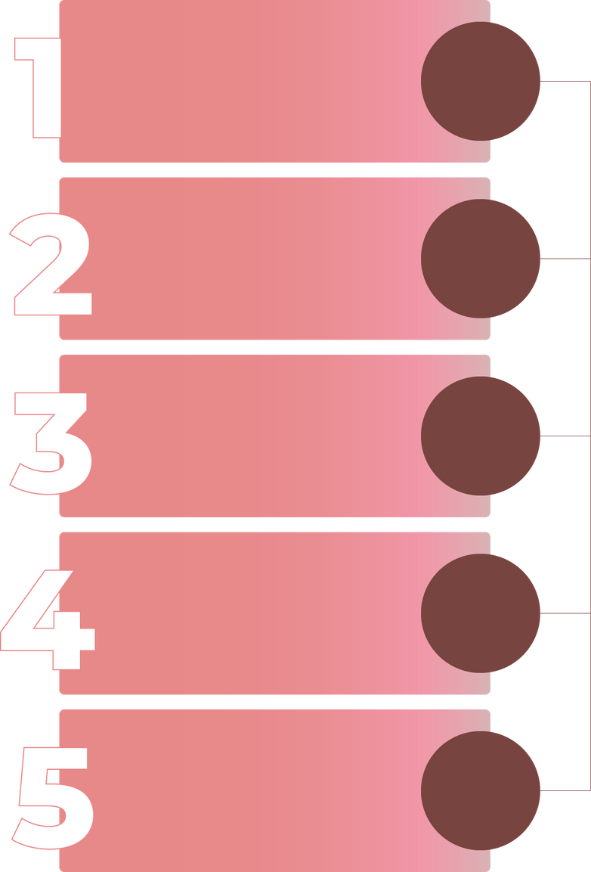
Red Flags and Urgent Referral
Obstetric Emergency
Pre-eclampsia: High Bp, Headaches, Visual disturbances, Swelling
Placenta previa/Abruption: Vaginal bleeding, abdominal pain
Reduced movement of baby
Identification of red flag
Stop Physio intervention
Gynae Malignancies
Abnormal vaginal bleeding (post menopausal, Post coital, intermenstrual)
Assess Severity & Urgency
Infection
Fever, Pelvic Pain, Kidney pain, Abnormal Discharge
Escalate
A+E/Antenatal triage
When to escalate
Sudden onset/severe symptoms
Progressive neurological signs eg. cauda equina
systemic illness: fever, unexplained weight loss
Document
Notes:
Slide 7: Recognising Red Flags & Urgent Referral
Obstetric Emergencies
Pre-eclampsia: A potentially life-threatening condition marked by high blood pressure, severe headaches, visual disturbances (blurred vision, flashing lights), and swelling of face/hands. As physios, if we see these symptoms in a pregnant client, it’s an immediate referral to obstetric care.
Placenta previa or placental abruption: Both present with vaginal bleeding during pregnancy (with or without pain). Placenta previa is painless, abruption is often painful with uterine tenderness. Any bleeding in pregnancy is a red flag requiring urgent referral.
Gynaecological Malignancies
Early detection is crucial — physios may be the first health professional a woman discloses symptoms to.
Red flag symptoms: unexplained or abnormal vaginal bleeding (especially post-menopause or between periods), persistent bloating, pelvic or abdominal pain, and unexplained weight loss.
Our role: we do not diagnose but must recognise when symptoms are concerning and escalate appropriately.
Severe Infections
Pelvic inflammatory disease (PID): can progress rapidly to sepsis or infertility if untreated.
Symptoms include pelvic pain, fever, unusual discharge, painful intercourse, or pain on urination.
Any suspicion of acute infection with systemic features → urgent medical review.
When to Escalate Care
Physiotherapists should always be alert to:
Sudden onset of severe or worsening pain
Progressive neurological symptoms (e.g., bladder/bowel dysfunction, saddle anaesthesia → think cauda equina)
Systemic illness signs (fever, night sweats, unintended weight loss)
Obstetric emergencies (bleeding, hypertension, seizures, fluid loss)
If any of these are present → immediate referral to emergency services, GP, or specialist team depending on severity.

Slide 14
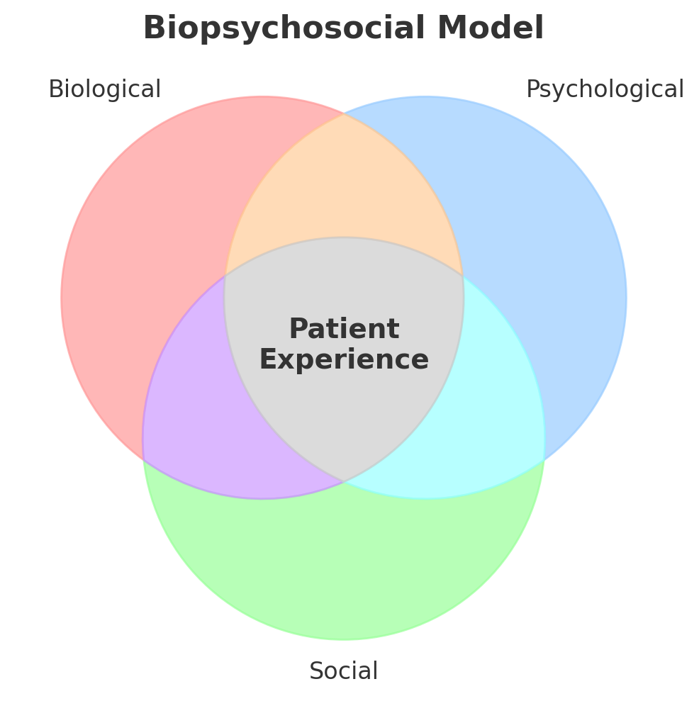
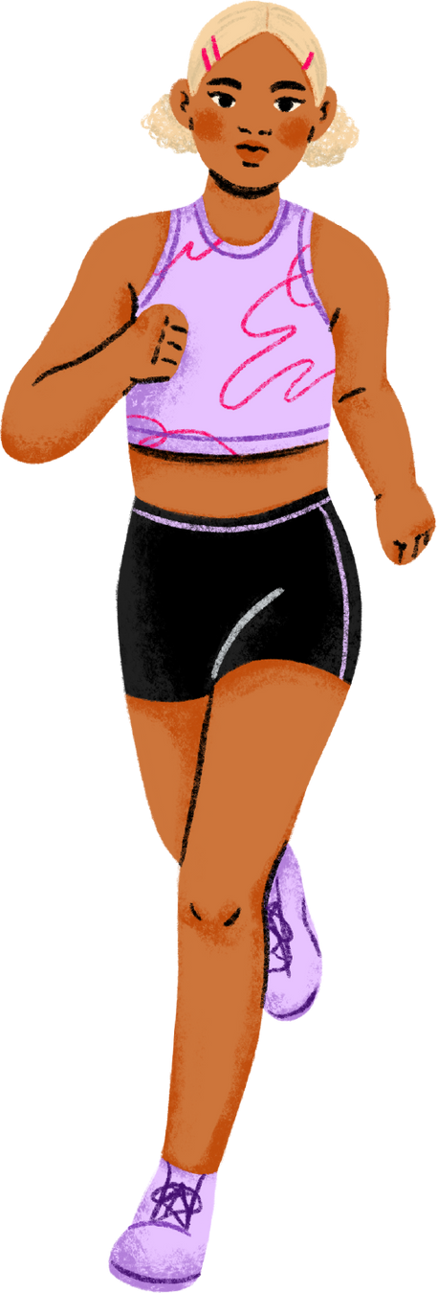
Biopsychosocial impact of womens health conditions
Notes:
Slide 8: Biopsychosocial Impact of Women’s Health Conditions
“This slide brings together the biopsychosocial impact of women’s health conditions, which is central to physiotherapy practice.
Effects on Quality of Life
Conditions such as urinary incontinence, prolapse, or pelvic pain have a huge effect on everyday living. Women may avoid leaving the house, socialising, or sexual activity due to symptoms or embarrassment.
Work and caregiving roles are often disrupted. Even simple activities like lifting children, exercising, or travelling can become restricted.
Physical Function Limitations
Physically, these conditions reduce ability to participate in sport, exercise, and even daily household tasks.
Pain syndromes, fatigue, or incontinence can all lead to reduced mobility and deconditioning. This creates a vicious cycle — symptoms cause inactivity, inactivity worsens physical and emotional health.
Mental Wellbeing
The psychological impact is significant.
Many women experience anxiety, depression, embarrassment, or loss of confidence.
There is also stigma — symptoms like urinary leakage or prolapse are often hidden, leading to isolation.
This makes addressing the psychological and social context just as important as addressing the physical symptoms.
Research Evidence
Nygaard et al. (2010) showed that urinary incontinence is associated with a significant reduction in quality of life and an increased risk of depression.
Broader literature shows up to 50% of women with pelvic floor dysfunction report negative impacts on mental wellbeing, self-esteem, and relationships.
Visual (Biopsychosocial Model)
On the slide, you’ll see a simple diagram with three circles: Biological, Psychological, and Social factors, overlapping into the central “Patient Experience.”
This model helps us remember that symptoms don’t exist in isolation. For example, urinary incontinence (biological) may cause exercise avoidance (social), which leads to embarrassment and low mood (psychological). Our physiotherapy care must consider all of these layers.”

Slide 15
Biopsychosocial Case study
A 31-year-old woman has noticed urine leakage when she runs or jumps. She used to run regularly but has stopped because of embarrassment and frustration. She worries that her symptoms mean something is “wrong” with her body. She feels self-conscious about exercise and has noticed her mood declining since she stopped being active.
Biological
Psychological
Social
  SUI
  PF weakness? dysfunction
  Changes in connective tissue or muscle tone
  Impact on CV and MSK system
  Embarrassment and shame
  anxeity about symptoms
  reduced self-efficacy
  low confidence with exercising
  low mood/frustration
  Avoidance fo running/group exercise
  withdrawal from social interactions
  Societal stigma
  impact on relationships
Notes:
A 31-year-old woman has noticed urine leakage when she runs or jumps. She used to run regularly but has stopped because of embarrassment and frustration. She worries that her symptoms mean something is “wrong” with her body. She feels self-conscious about exercise and has noticed her mood declining since she stopped being active.
Biopsychosocial Mapping
1. Biological (physical/medical factors)
Stress urinary incontinence (leakage with running/jumping)
Possible pelvic floor weakness or dysfunction
Changes in connective tissue or muscle tone postpartum (if relevant)
Impact on fitness, cardiovascular health, and musculoskeletal system due to reduced activity
2. Psychological (thoughts, emotions, beliefs)
Embarrassment and shame associated with leakage
Anxiety about symptoms indicating something “wrong”
Reduced self-efficacy or confidence in exercising
Possible low mood or frustration from being less active
3. Social (environmental/relationship factors)
Avoidance of running or group exercise due to fear of leakage
Possible withdrawal from social interactions or exercise groups
Influence of societal stigma around incontinence
Impact on relationships or family life if activity was shared with partner/friends
Discussion / Reflection Questions for Students
How do her biological, psychological, and social factors interact to influence her behavior?
What might be the long-term consequences if she does not receive support or treatment?
What interventions could address each domain (e.g., physiotherapy, cognitive support, social encouragement)?
How could you approach goal setting to restore confidence in exercise?

Slide 16
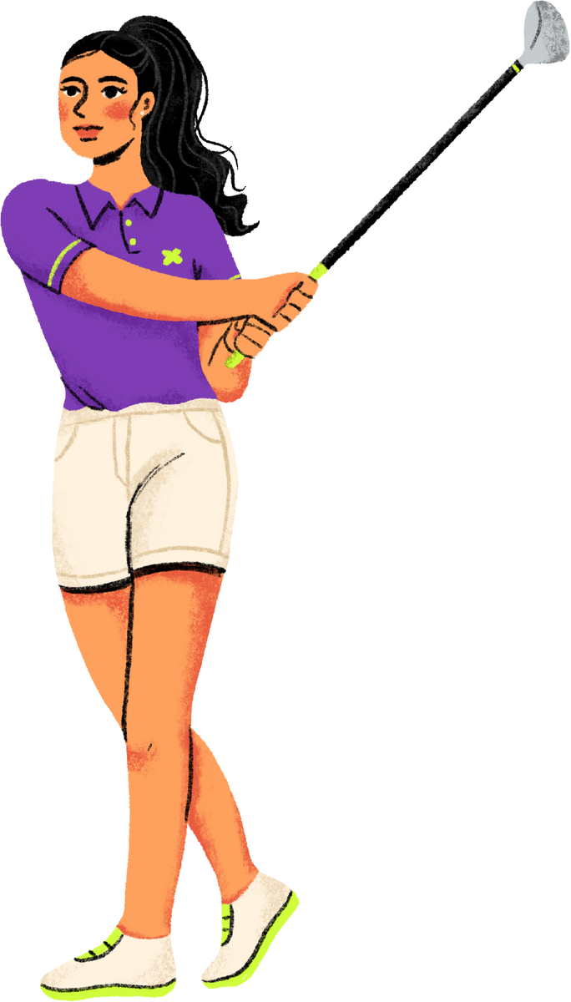
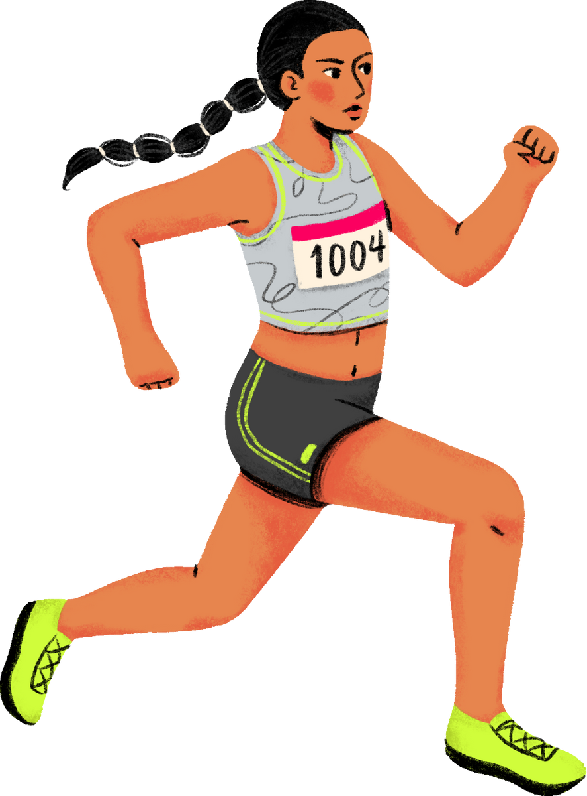
Thank You for your attention
Imogen Pallister B8aPT
Pelvic Health Physio Barts Health
imogen.pallister2@nhs.net

